Slide 1
Coordination and Collusion in Three-Player Strategic Environments
Ya’akov (Kobi) Gal
Department of Information Systems Engineering
Ben-Gurion University of the Negev
School of Engineering and Applied Sciences,
Harvard University

Slide 2


Motivation
People interact with computers more than ever before.
Examples: electronic commerce, medical applications.
Can we use computers to improve people’s performance?

Slide 3

Encouraging Healthy Behaviors

Slide 4
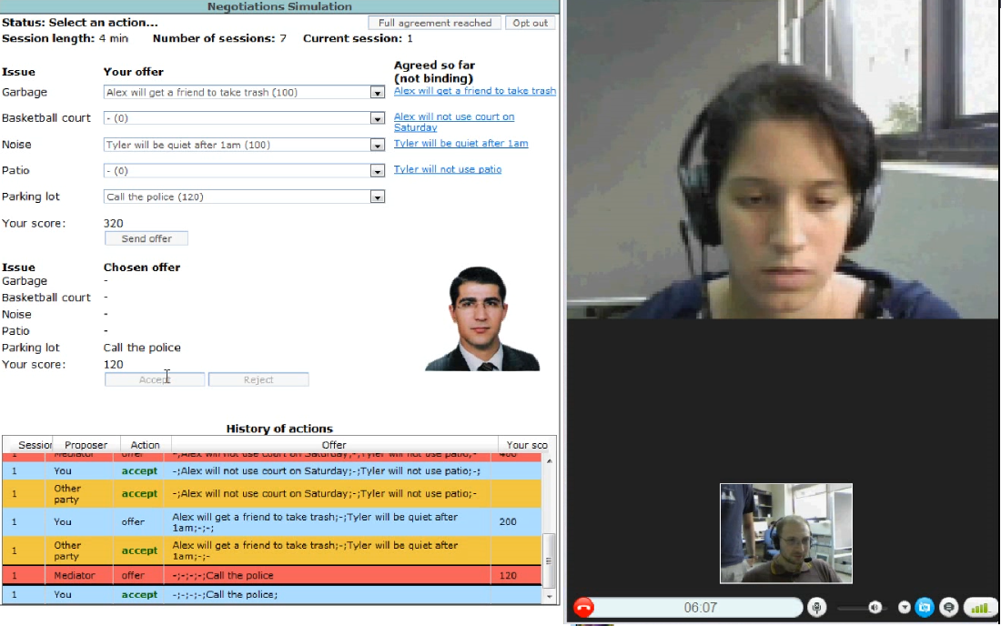
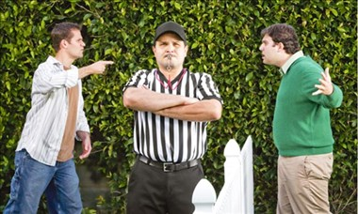
Application: Automated Mediators for Resolving Conflicts

Slide 5


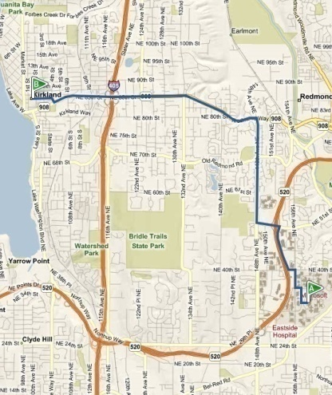
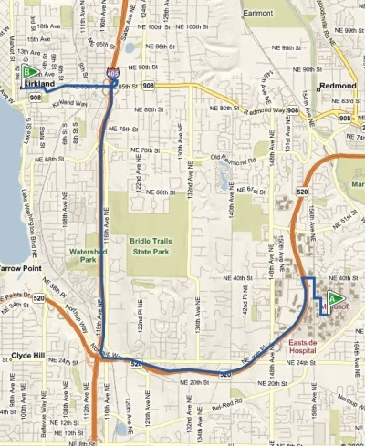
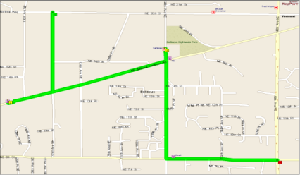
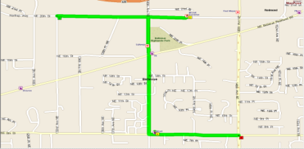

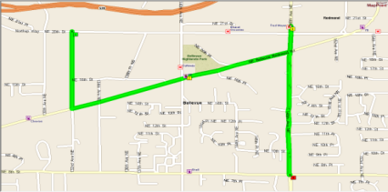

“Opportunistic” Route Planning [Azaria et al., AAAI 12]
most effective
commute
drive home
opportunistic commerce
Route A
Route B
Notes:
MC-Market: ongoing search and negotiation
Finds best trade-off

Slide 6

Computers as Trainers
Good idea, because computers
  are designed by experts.
  Use game theory, machine learning.
  Always available.
Notes:
The media equation

Slide 7
Computers as Trainers
Bad idea, because computers
  Deter and frustrate people.
  Difficult to learn from.
  Do not play like people.
Notes:
The media equation

Slide 8

Questions
How do humans play the LSG?
How will automated agents handle an environment with humans?
Can automated agents successfully cooperate with humans in such environment?
Can human learn and improve by playing with automated agents?

Slide 9
Methodology
Subjects to play the LSGin a lab. No subject knows the identity of his opponents.
Subjects are paid by performance over time.
Used state-of-the-art Automated agents for training and evaluation purposes.
Show instructions
* Testing agent: EAsquared(Southampton). * Training agents: GoffBot (Brown), MatchMate(GTech).
Notes:
Mention the names the three computer agents,.

Slide 10
Empirical Methodology
Subject played 3 sessions of 30 rounds each.
The first two sessions were “training sessions” using
  two automated agents
  one automated agent
  no automated agents
Testing always included two people and a single “standardized” agent.

Slide 11
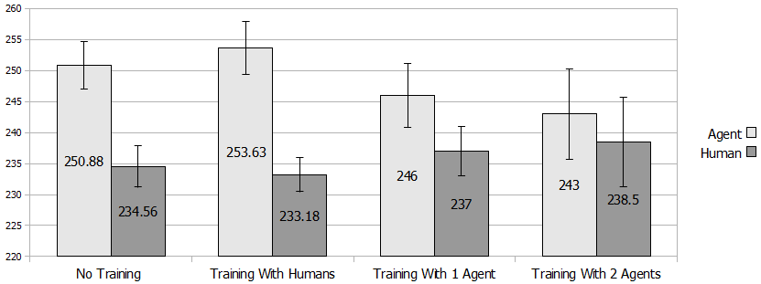
Performance results
Training with more computer agents = better performance.

Slide 12
Performance results
Training with more computer agents = better performance.

Slide 13

Behavioral Analysis
People are erratic

Slide 14
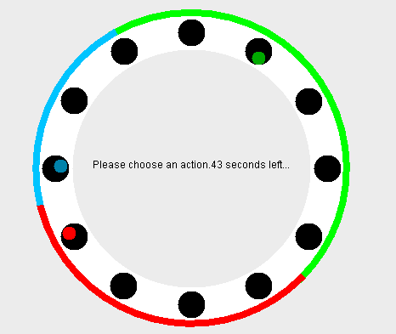
People play erratically
People simple heuristic – move to the middle of the large gap between the two opponents
Notes:
More animation
Yaniv : Done

Slide 15
People play erratically
People simple heuristic – move to the middle of the large gap between the two opponents

Slide 16
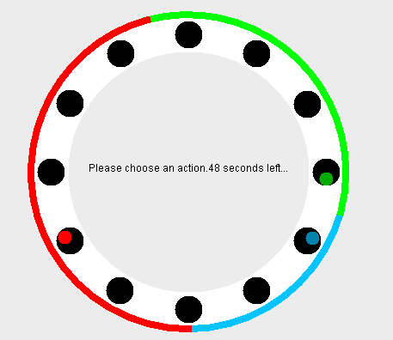
People play erratically
People simple heuristic – move to the middle of the large gap between the two opponents

Slide 17
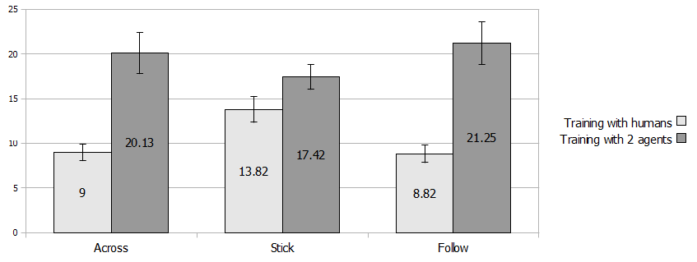
Cooperative Behavior Analysis
Stick: pos_k[i+1]=pos_k[i]
Follow: pos_k [i+1]=across(pos_j[i]); j not = k
Notes:
Show only people and in a bar chart - done

Slide 18
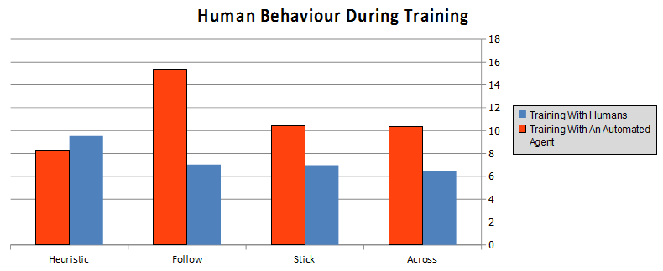

Slide 19
Implication
Difficult for people to identify opportunities for cooperation in 3-player games
  In contrast to results from 2-player PD games.
Computer agents can help people improve their performance, even in strictly competitive environments with three players.

Slide 20
Other issues and Next Steps
Does programming an agent increases subjects performance in the game?
  YES (see paper)
How do people behave when there is no automated agent in the testing epoch?
  Highly erratic
Can we make people the basis of the next LSG tournament?

Slide 21

Artificial Intelligence Research at BGU
14 Faculty Members
Over 20 graduate students
Cutting-edge research

